Slide 1
Coursera-Capstone Project
Battle Of Neighborhoods
Akshata Patil

Slide 2
Table Of Contents
SI.No. | Content | Slide No.
1 | Introduction | 3
2 | Introduction of Project | 4
3 | Data Requirements and Collection | 5-6
4 | Data Analysis | 6-18
5 | Conclusion | 19
Project Reference:
Git Hub Link:
https://github.com/Akshata1992/Coursera_Capstone/blob/master/Battle%20Of%20Neighborhood.ipynb

Slide 3
Introduction
Capstone Project is a process to pursue independent research on a question or problem of their choice, engage with the scholarly debates in the relevant disciplines, and - with the guidance produce a substantial paper that reflects a deep understanding of the topic.
In regards to above definition, the idea chose for the project is stated as below,
“Why Bengaluru is the best place to live in India”
Project is of two week assignment where first part involved presenting the idea for the project, problem statement, details and methods of data to be used in project. Second part involved analysis and presenting data(coding) to prove the objective of the project along with documenting the report of analysis.
Grading is based on peer-graded evaluation.

Slide 4
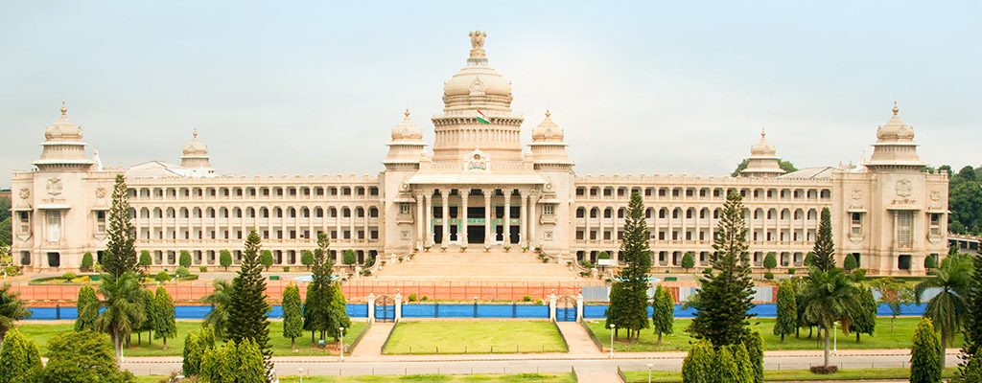
Introduction Of Project:
Bangalore (Bengaluru)!!, is the capital of the Indian state of Karnataka. It is the third most popular megacity in India, next to Mumbai and Delhi. City is referred to as the "Silicon Valley of India",‘ City of Gardens', and 'Pub Capital of India'.
The city features an exciting nightlife with a host of exotic pubs. The diversity of the city attracts many people within the country and around the world.
As a resident of the city, to people who are looking for best place to stay in the country let me tell you, "Why Bangalore is the best to live in India."

Slide 5
Data requirements and collection:
Objective of the project is to explore the city on different aspects which are considered to be factors that people look into while choosing the place to live in country.
Most of the data is collected from Wikipedia, websites and Foursquare API. Below is the details of links for data collected and how the data is used in the project.
City is explored into following categories and data will be represented in terms of statistics tables and graphs to highlight the objective the project.
Geography : Population and Climate details
Infrastructure, Culture, Tourist places
Food, Shopping, Nightlife and Fun
Economy

Slide 6
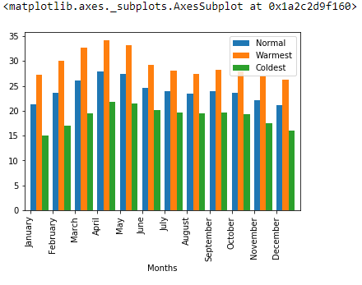
Data Analysis:
Geography: Climate conditions

Slide 7
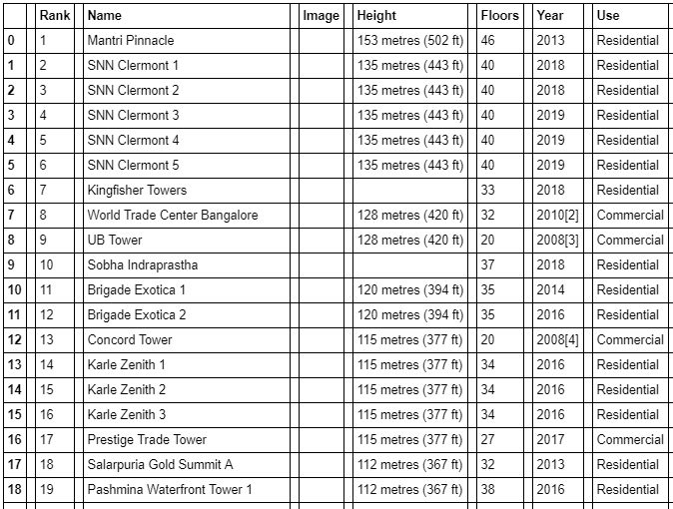
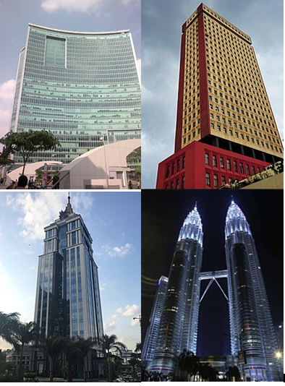
Infrastructure, Culture, Tourist places:

Slide 8
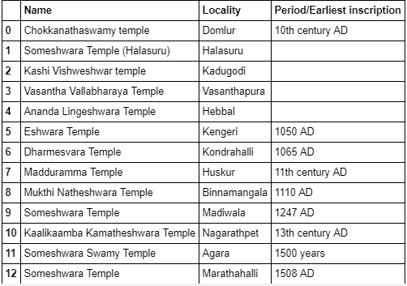
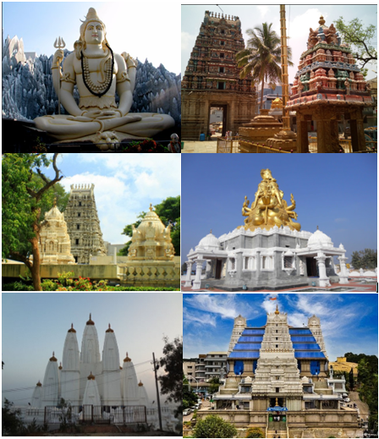
Culture:

Slide 9
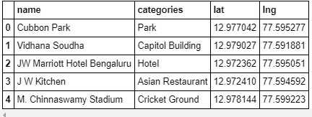
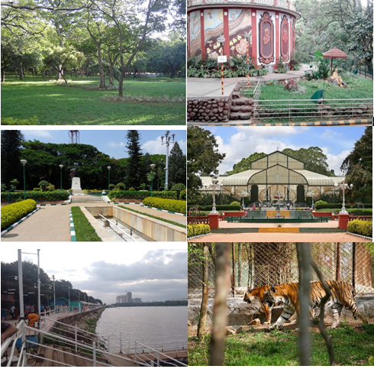
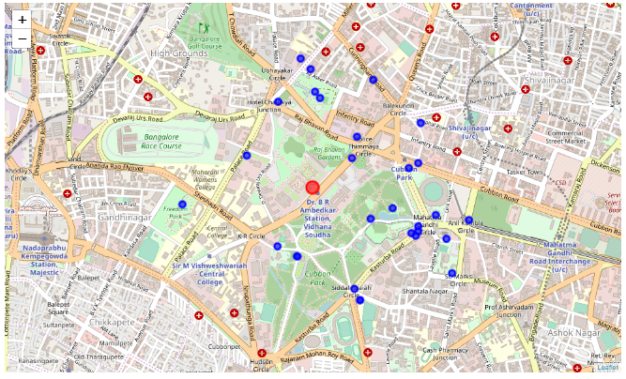
Parks:

Slide 10
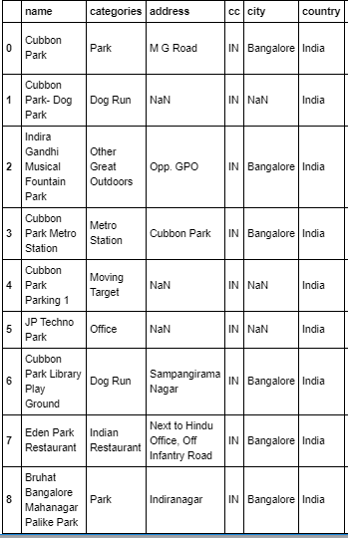
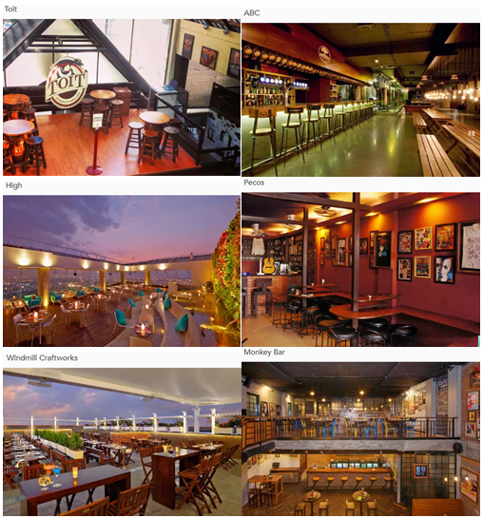
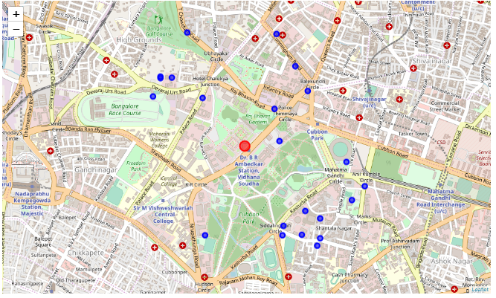
Bars

Slide 11
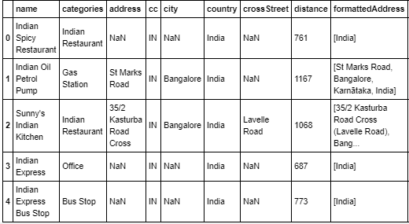
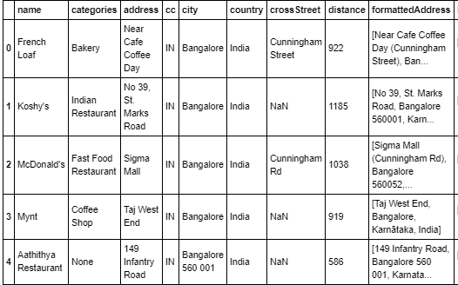
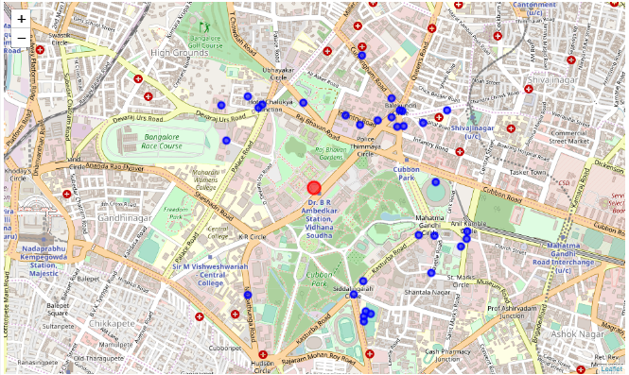
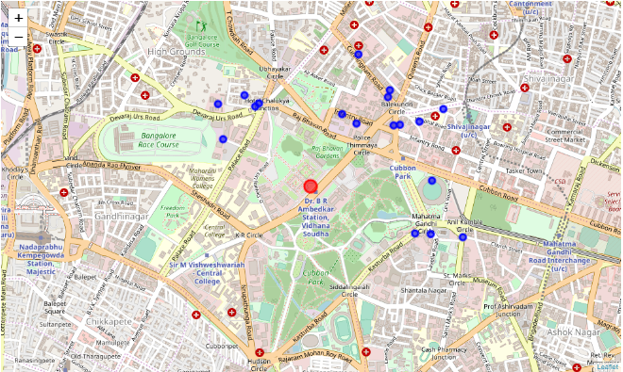
Bangalore has all kinds of cousines when comes to food. Here are some of the restaurant list and geographical coordinates.

Slide 12
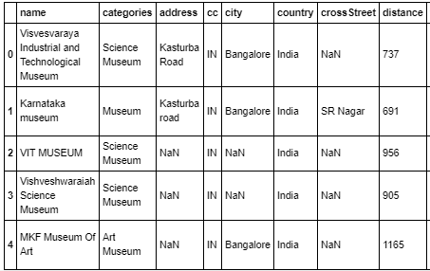
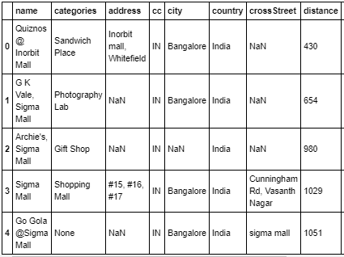
Museum and Shopping malls

Slide 13
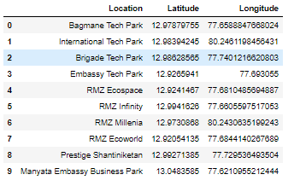
Economy: IT Tech Parks

Slide 14
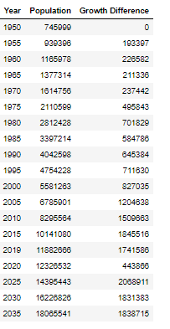
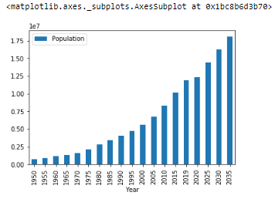
Conclusion:
According to a global survey, Technology hub Bangalore has been ranked the best Indian city to live in. Bangalore beat Delhi, Mumbai, Chennai and Calcutta to emerge as the leading city for its quality of life. Five Indian cities make the list, which Bangalore leads for quality of living and personal safety standards, a measure of stability and crime levels. Bangalore is followed by the capital, Delhi (global rank: 143), Mumbai (144), Chennai (150) and Calcutta (151).Bangalore is home to nearly 8.5 million people. It has more than 1,500 multinational software companies, is an information technology hub and is often referred to as the Silicon Valley of India. Most of the people fall in love with the city just because of its climate.it is one of the main reasons behind people migrating from other states to the city. The weather of Bangalore has always been a key attraction for the people. The morning is bright and sunny and the nights are cooler offering you a pleasant stay. Bangalore blends together the elements of traditional and modern lifestyle and value at the same time. There are places like MG road, Brigade Road, and Commercial Street, where the youth can go and enjoy shopping and socializing. Below is the graphical representation of population of city from 1950 to projected value till 2035(projected) which is increasing yearly indicating that the city attracts people on factors explored in the project to choose Bengaluru as the best place to live.

Slide 15
Thank You…

